Slide 1

Final Project HIC
67298
Eitan Stepanov | 208345017
Eitan Coronel | 315468132

Slide 2
Challenge number 1
The problem we want to resolve: Children with disabilities may struggle to achieve equal effort on both legs while riding a bike for different reasons.
We want to give them feedback in real time about the efforts they make on each leg to give them the opportunity to improve while doing it in a consistant way.

Slide 3
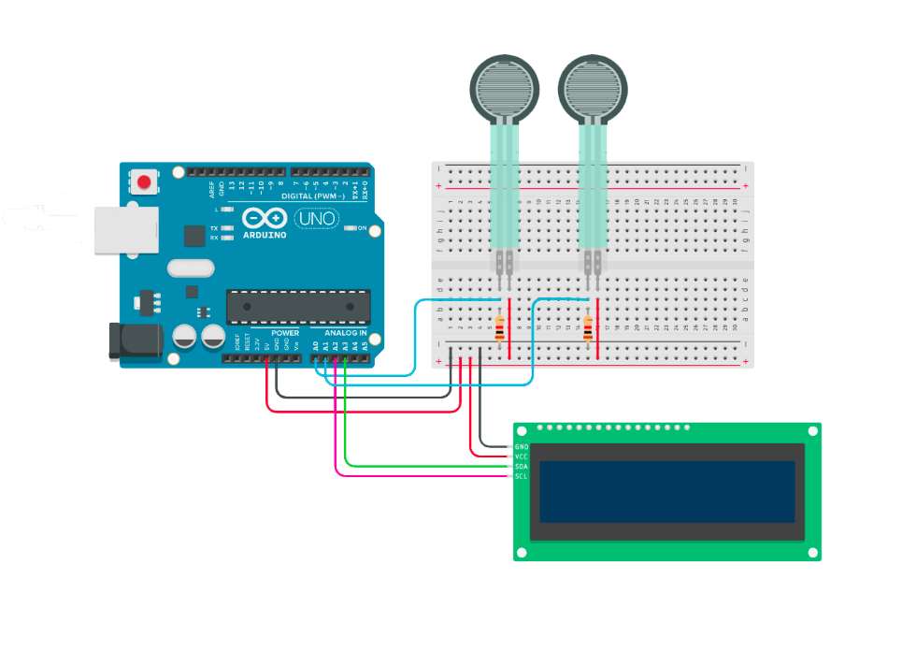

Technical drawing of the electronic circuit
In this project we are using:
Arduino board
2x pressure sensors (one for each leg)
LCD I2C display
Some Resistors
Output monitor (computer)
Virtual Agent
Feedback monitor

Slide 4
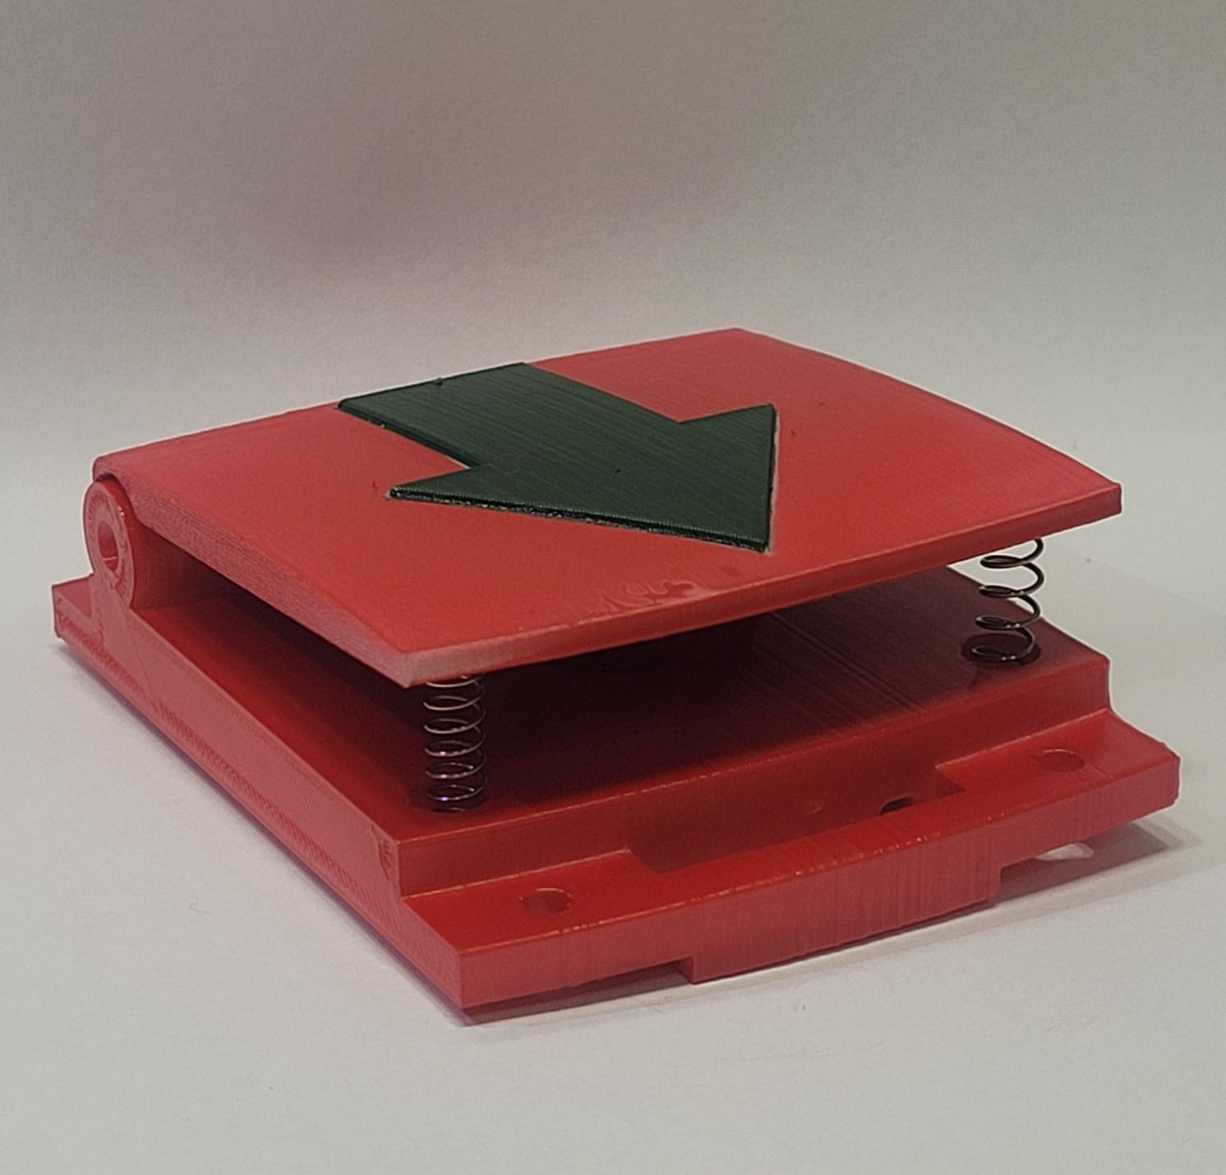
Physical Agent
3D printed object: Rhino

Slide 5
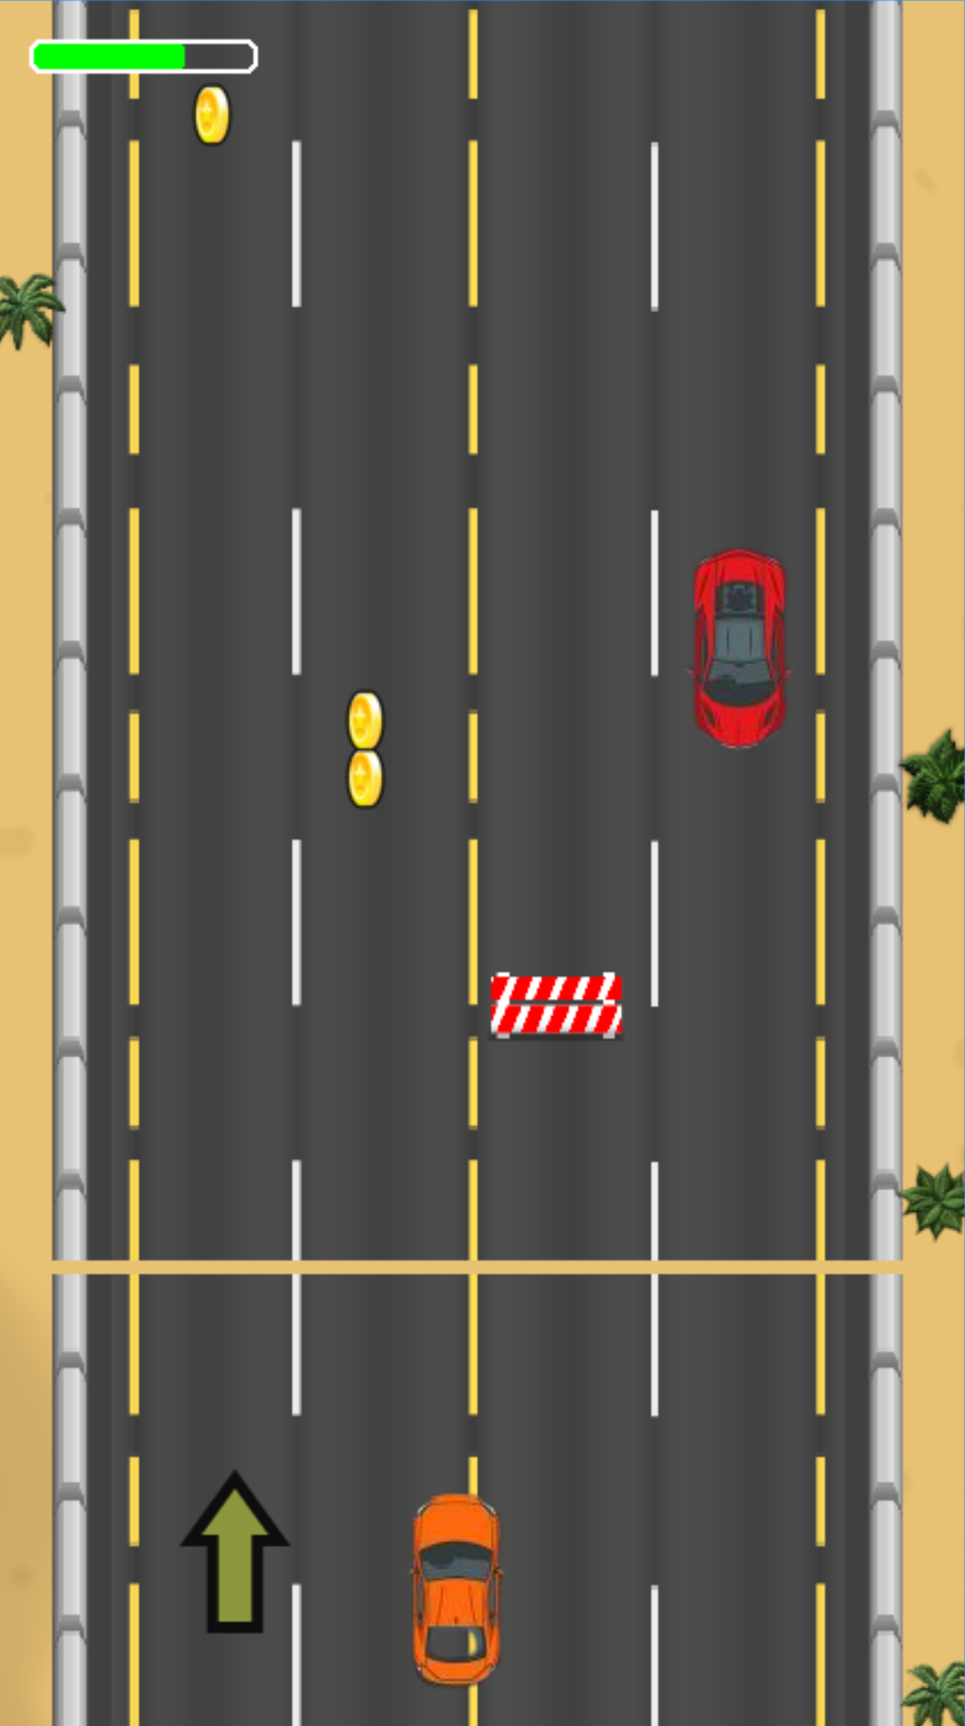
Visual Agent
The game is modular and infinite
First gesture - pressure distribution between legs
Second gesture - pedal consistency

Slide 6


